Slide 1
The Battle of Neighborhoods New York City Vs Toronto
By,
Suruthi Vinoth Kannan

Slide 2
Introduction
In this project we are going to explore the neighborhoods of the most popular cities, New York and Toronto.
They are the international centers of business, finance, arts, culture, and are recognized as the most multicultural cosmopolitans in the world. They are diverse in many ways.
One interesting idea would be to compare the neighborhoods of the two cities and determine how similar or dissimilar they are.

Slide 3
Problem Description
Let me explain the idea of this project through a scenario. Say you live in the New York City of USA. You love your neighborhood, mainly because of all the great amenities and other types of venues that exist in the neighborhood, such as gourmet fast food joints, pharmacies, parks, and so on.
Now say you receive a job offer from a great company which is in Toronto, Canada with great career prospects. However, given the far distance from your current place you unfortunately must move if you decide to accept the offer.
Wouldn't it be great if you are able to determine a neighborhood that are the same as your current neighborhood, and if not, perhaps a similar neighborhood that are at least closer to your new job?

Slide 4
Target Audience
We will study and analyze the neighborhoods of both the cities and group them into similar clusters and, analyze those clusters to gather meaningful information. That information can be used to find out neighborhoods that are same as your current neighborhood or at least similar.
The information provided by this project would be useful for people who are interested in relocating to different places and are interested in finding new neighborhoods that are highly similar to their existing neighborhood.

Slide 5
Data Description
The NYC neighborhood data exists for free on the web. Here is the link to the dataset:
https://geo.nyu.edu/catalog/nyu_2451_34572.
For Toronto neighborhood data, a Wikipedia page: https://en.wikipedia.org/wiki/List_of_postal_codes_of_Canada:_M,
exists that has all the information we needed to explore. We will scrape the Wikipedia page and wrangle the data, clean it, and then read it into a pandas data frame.
Note: There are different website scraping libraries and packages in Python. We can simply use pandas to read the table into a pandas data frame. Another way, for more complicated cases of web scraping is using the Beautiful Soup package. Here is the package's main documentation page:
http://beautiful-soup-4.readthedocs.io/en/latest/

Slide 6
Method
For this problem, we will get the services of Foursquare API to explore the data of two cities, in terms of their neighborhoods. The data include the information about the places around each neighborhood like restaurants, hotels, coffee shops, parks, theaters, art galleries, museums and many more. In order to utilize the Foursquare location data, we need to get the latitude and the longitude coordinates of each neighborhood. Here is a link to a csv file that has the geographical coordinates of each postal code of Toronto: http://cocl.us/Geospatial_data.
We will use the machine learning technique, “Clustering” to segment the neighborhoods with similar objects on the basis of each neighborhood data.
Finally, you will use the Folium library to visualize the neighborhoods in New York City and their emerging clusters.

Slide 7
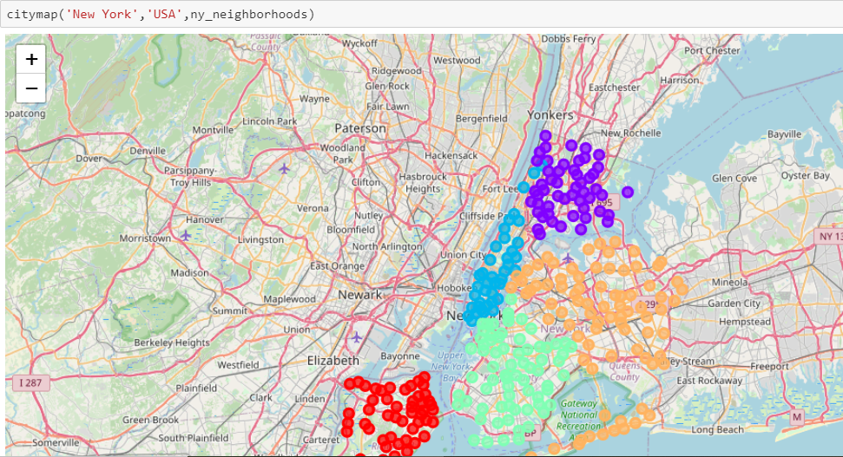
Visualization of New York City Neighborhood data

Slide 8
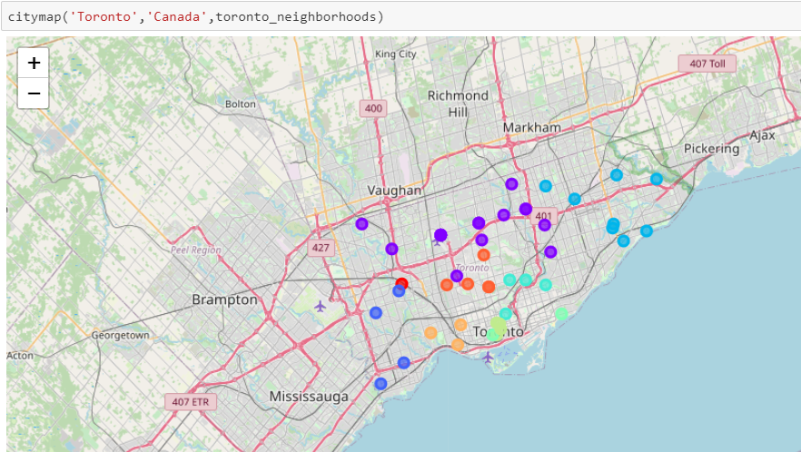
Visualization of Toronto City Neighborhood data

Slide 9
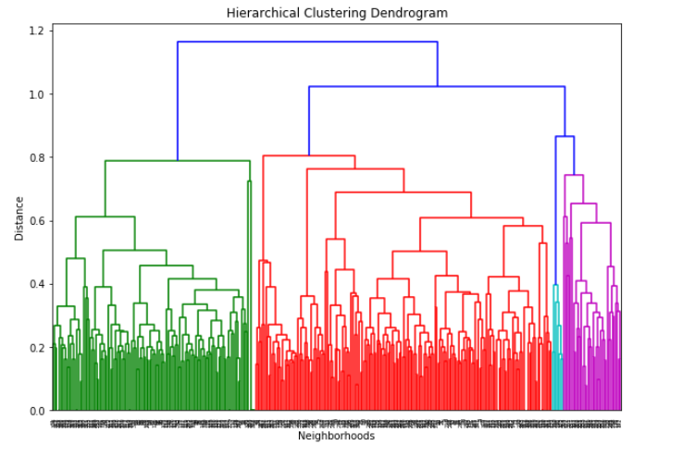
Hierarchical Clustering Denrogram of Neighborhoods

Slide 10
Results
Total Number of Neighborhoods in each cluster,
Cluster 0 – 36 neighborhoods
Cluster 1 – 5 neighborhoods
Cluster 2 – 141 neighborhoods
Cluster 3 – 7 neighborhoods
Cluster 4 – 26 neighborhoods
Cluster 5 – 121 neighborhoods
Cluster 6 – 17 neighborhoods

Slide 11
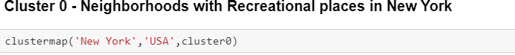
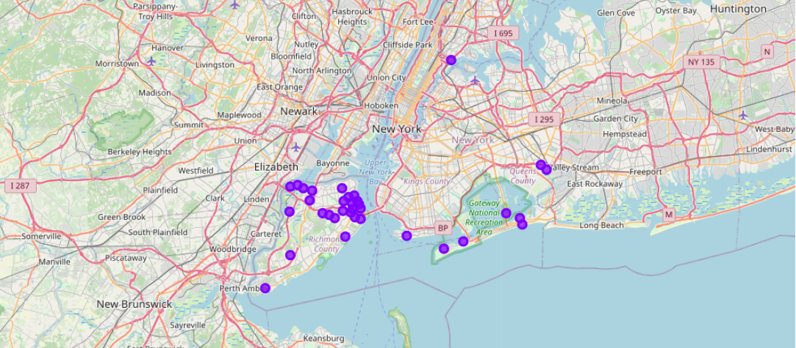
Explore the neighborhoods with similar clusters using map

Slide 12
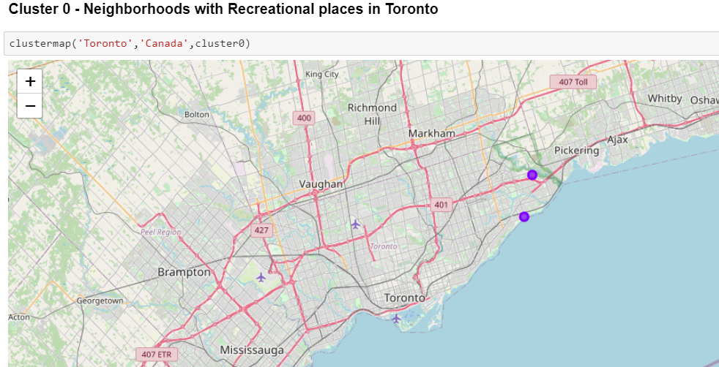
Explore the neighborhoods with similar clusters using map

Slide 13

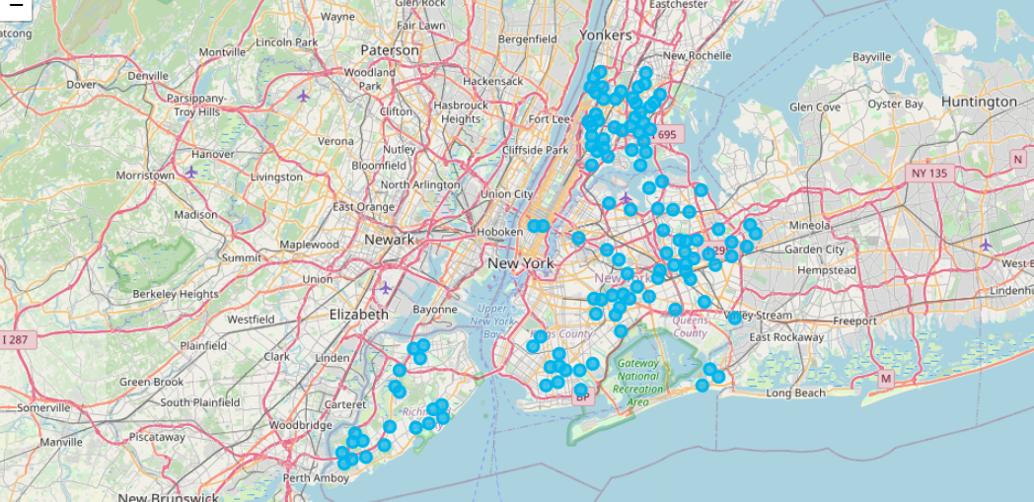
Explore the neighborhoods with similar clusters using map

Slide 14
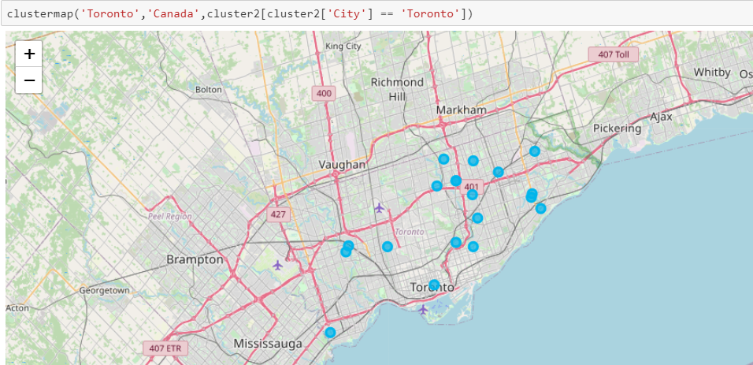
Explore the neighborhoods with similar clusters using map

Slide 15
Conclusion
With all the analysis we have done, we can conclude that,
Cluster 0 - Neighborhood with all type of Recreational centers
Cluster 1 - Neighborhood with Sports Complex
Cluster 2 - Neighborhood with Super markets, malls - (Residential)
Cluster 3 - Neighborhood with Beach
Cluster 4 - Neighborhood with more no. of Italian restaurants
Cluster 5 - Neighborhood with Pub, Bar and Sushi places
Cluster 6 - Neighborhood with more no. of Caribbean restaurants

